Slide 1
LTU – ECE Department EEE 5653 – 1740 & EEE 5654 - 1257 Digital Signal Processing Final Project Requirements
Dr. Heri Rakouth/Dr. Linda Murphy
05 December 2023
Heri Rakouth

Slide 2
Introduction
You will be using Matlab and Simulink for this project. You will be working in teams of 2. Each team will have two filters to design for their investigations. The 4 main filters are:
High pass
Low pass
Band pass
Notch
Each group will be assigned one filter set from the four ones defined in Table 1 below.
 | Filter Set Allocation
 | Filter Set 1 | Filter Set 2 | Filter Set 3 | Filter Set 4
High Pass |  | Not Available |  | Not Available
Low Pass | Not Available |  | Not Available
Band Pass |  | Not Available | Not Available
Notch | Not Available |  |  | Not Available
Table 1. Filter Set Specification

Slide 3
Group Filter Set Selection
The two-some groups shall be formed by self-selected pairs of students within the same class, either EEE5653-1740 or EEE5654-1257. No cross-over is allowed.
On a first come - first served basis, one or both members of each group will email the instructor a documented copy of the embedded Excel file relevant to each class from Table 2 below by 7:00PM on Saturday 11/18.
The documentation pertains to cells A4 through D5 of the worksheet “Group’s Choices” (from the relevant Excel file in Table 2) and shall be according to the example shown in Table 3.
The instructor will assign one filter set to each group. This assignment will be based on each group’s email time stamp along with the prioritized selection of 3 out 4 filter sets specified by each group in the emailed files.
Students unable to build a group will be assigned to groups to be formed during the Tuesday 11/21 Zoom session with the concerned students in attendance and by the instructor for the absent students.
EEE5653-1740 | EEE5654-1257
Table 2. Group – Documented Filter Set Choices
 | Group's Choices
Group Members | 1st Choice | 2nd Choice | 3rd Choice
Student 2 | Filter Set 2 | Filter Set 3 | Filter Set 1
Student 5
Table 3. Example of a group filter set selection

Slide 4
Finalized Group Assignment & Filter Performance Requirements
Group Assignment as of 21NOV23
Filter Performance Requirements as of 28NOV23
For each group, the performance requirements of each of the 2 assigned filters are defined in the EXCEL file with the filename “Project_Requirements_28NOV23.xlsx”
EEE5653-1740 | EEE5654-1257
Table 3. Group Assignment As of 21NOV23

Slide 5
Project Overview
The project includes the following 5 activities.
Activity 1: Build both filters identified in Slide 2. Their performance requirements will be specified after the freeze of the group assignment (i.e. by 11/21)
Activity 2: Analyze each filter’s performance vs. requirements according to the Simulink model defined in Figure 1 below.
Activity 3: analyze each filter’s ability (or lack thereof) to protect the primary input signal from a noisy environment (see Slide #21).
Activity 4: Present a demonstration during the final week.
Activity 5: Submit a project report by Thursday 12/14.
Time-domain
Frequency-domain
Analyzer
Signal/Pulse
Generator
Filter
Design
Figure 1. Project Setup

Slide 6
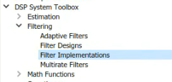
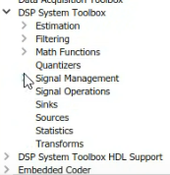
Activity 1 - Filter Design App/Simulink Block
Matlab command:
>> filterDesigner
Simulink block:
Open Simulink
Navigate to the DSP System Toolbox
Select Filtering - filter implementations
Choose the Digital Filter Design Block from the list.

Slide 7
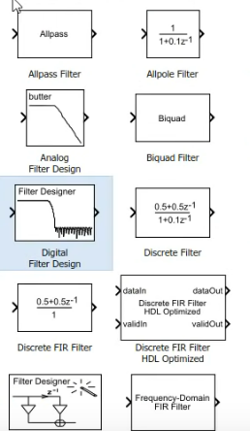
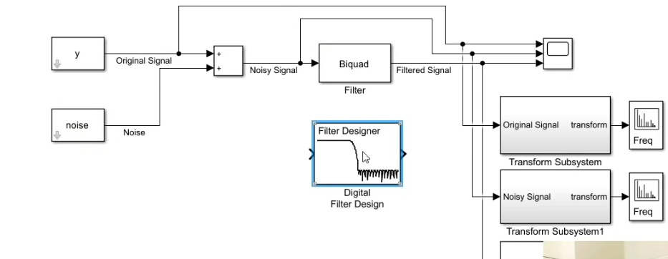
Activity 1 - Filter Design App/Simulink Block
Drag into the model you are creating

Slide 8
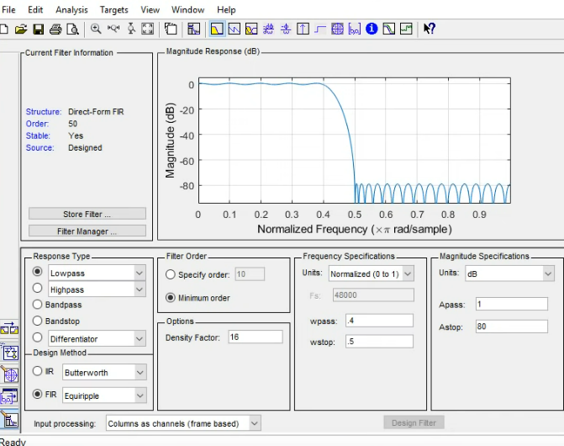
Activity 1 - Filter Design App/Simulink Block
Open the block to see the filter designer app

Slide 9
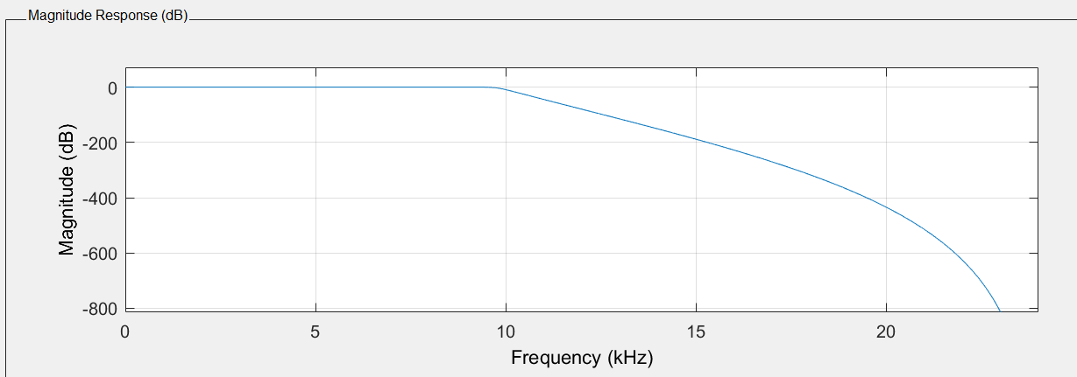
Activity 1 - Some Filter Design App Features
Once you generate a signal from the signal generator you can connect this block to a scope block and look at the plot to see what frequencies to attenuate.
From here you can find the sampling frequency and the cut-off frequencies for your filter design. By using the filter designer, several plots are available for you to see how your filter is performing.
Magnitude response:

Slide 10
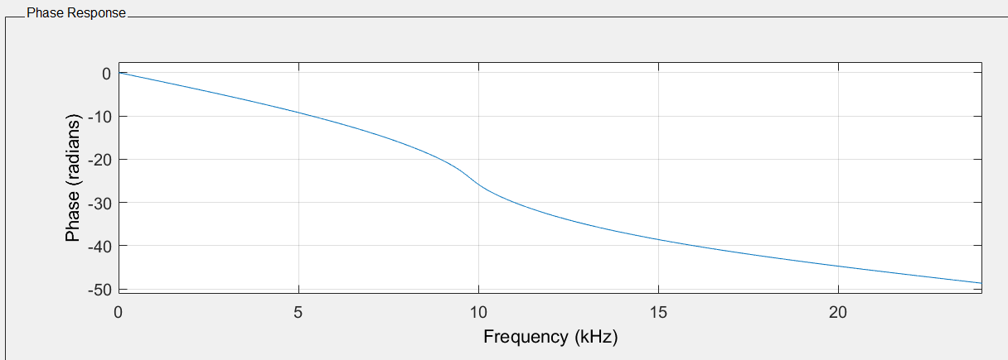
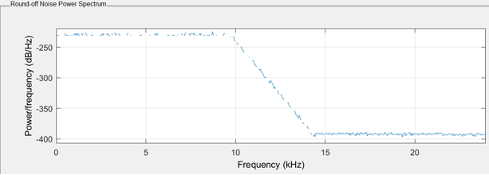
Activity 1 - Some Filter Design App Features
Phase response:
Round-Off Noise Power Spectrum:

Slide 11
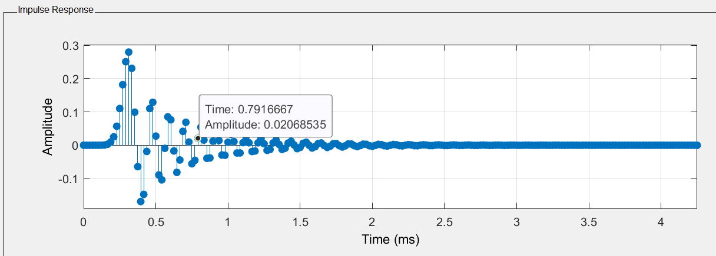
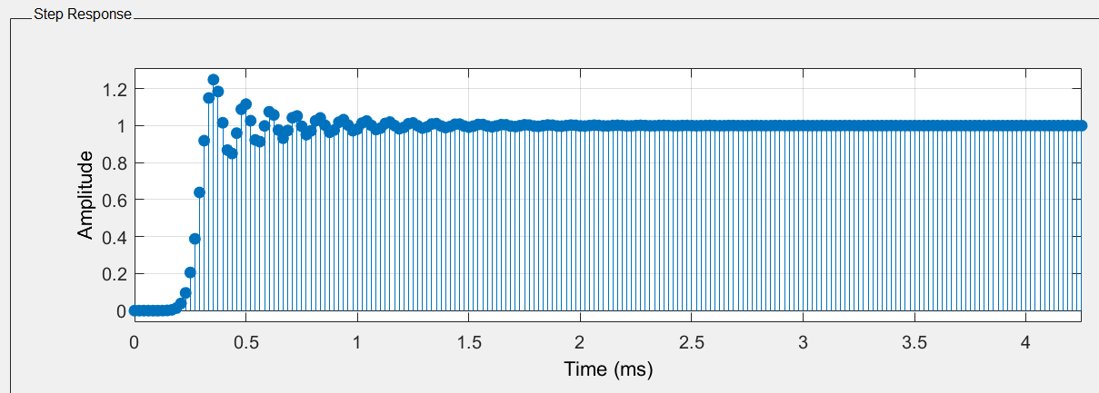
Activity 1 - Some Filter Design App Features
Impulse response:
Step response:

Slide 12
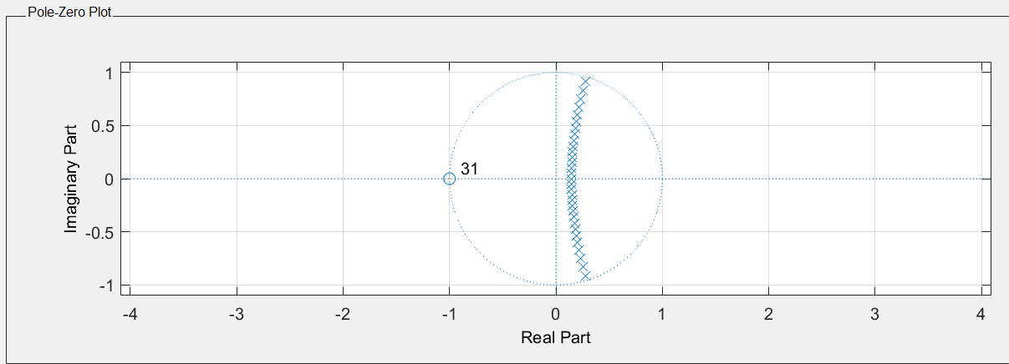
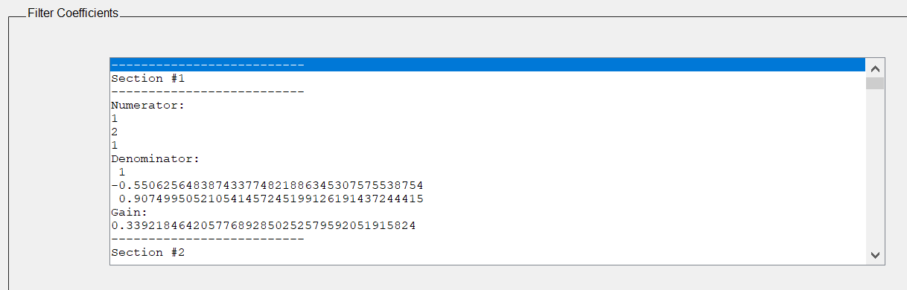
Activity 1 - Some Filter Design App Features
Pole-Zero Response:
Filter Coefficients:

Slide 13
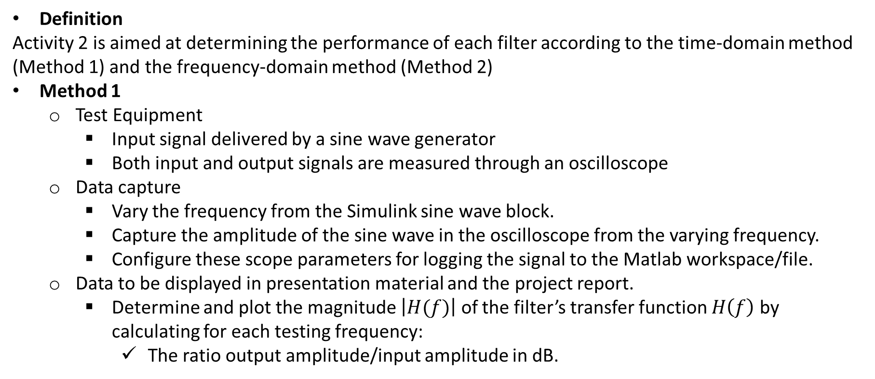
Methods for Activity 2 (1/2)
Definition
Activity 2 is aimed at determining the performance of each filter according to the time-domain method (Method 1) and the frequency-domain method (Method 2)
Method 1
Test Equipment
Input signal delivered by a sine wave generator
Both input and output signals are measured through an oscilloscope
Data capture
Vary the frequency from the Simulink sine wave block.
Capture the amplitude of the sine wave in the oscilloscope from the varying frequency.
Configure these scope parameters for logging the signal to the Matlab workspace/file.
Data to be displayed in presentation material and the project report.
Determine and plot the magnitude $\left|H(f)\right|$ of the filter’s transfer function $H\left(f\right)$ by calculating for each testing frequency:
The ratio output amplitude/input amplitude in dB.

Slide 14
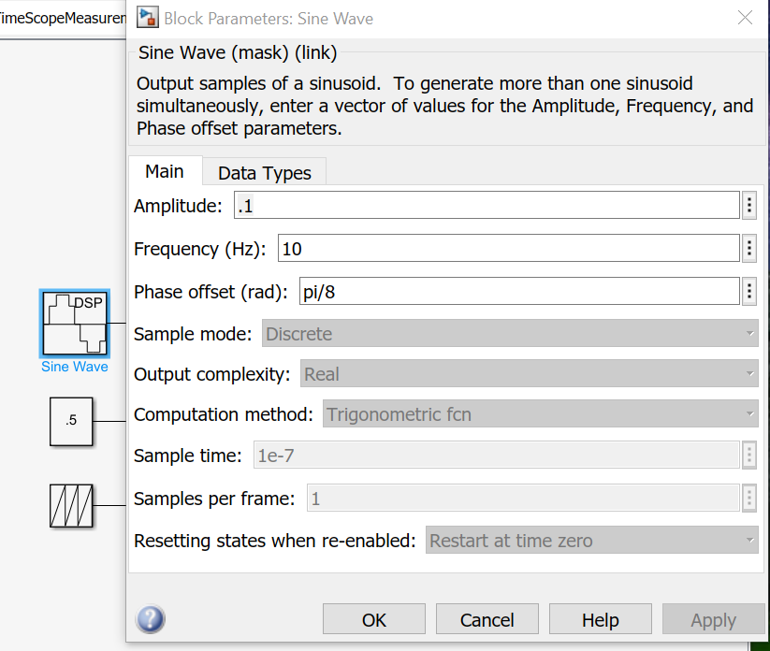
Activity 2 – Method 1 - Sine Wave Block
One idea you could try for adjusting the frequency for your sine wave block is to set the internal frequency of the sine function to 1 then multiply the input signal by the desired frequency. Another idea is to vary the frequency by feeding in a ramp to the sine block.
In time-based mode, the value of the sample time parameter determines whether the block operates in continuous mode or discrete mode.
Please refer to the MathWorks documentation for the Sine Wave block for more information.

Slide 15
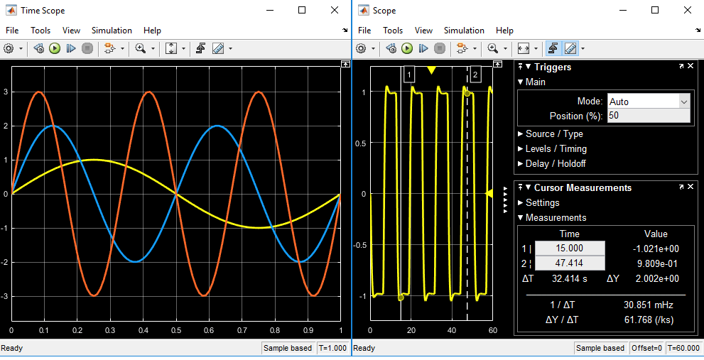
Activity 2 – Method 1 - Scope
The Simulink scope block and the DSP System Toolbox time scope block have identical functionality but they have different default settings. The Time Scope is optimized for discrete time processing. The scope is optimized for general time-domain simulation.
You can measure signal values using vertical and horizontal cursors. See MathWorks documentation for more details.

Slide 16
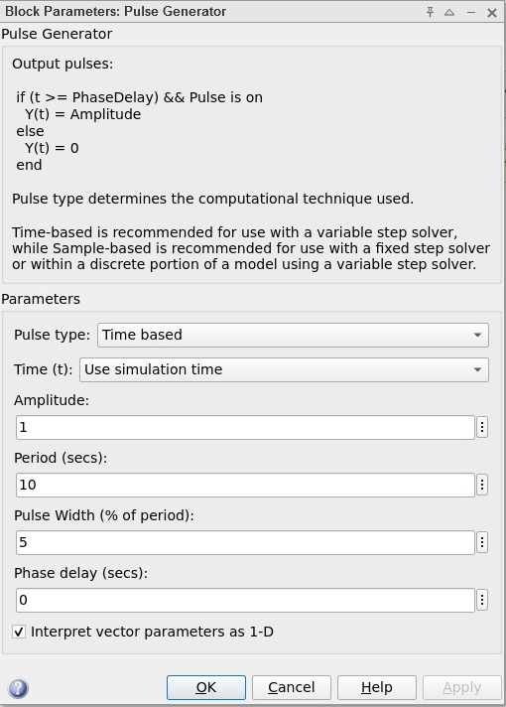

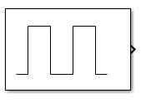
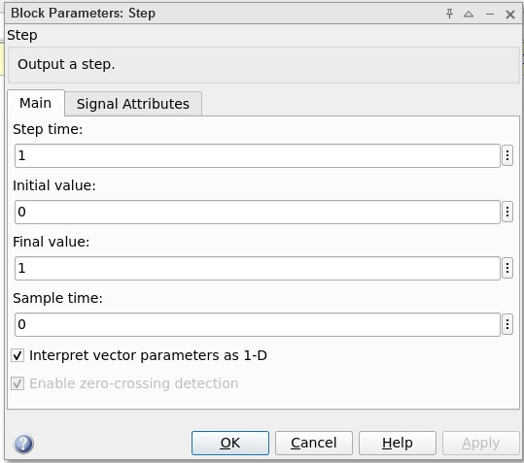
Activity 2 – Method 2 - Pulse Generator and Step Function
Some possibilities to investigate to create a Dirac.
Step Function
Pulse Generator

Slide 17
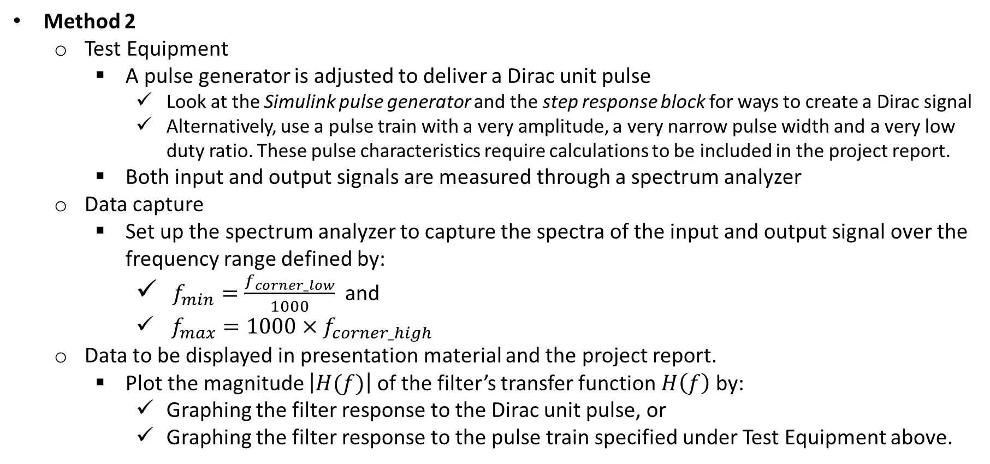
Methods for Activity 2 (2/2)
Method 2
Test Equipment
A pulse generator is adjusted to deliver a Dirac unit pulse
Look at the Simulink pulse generator and the step response block for ways to create a Dirac signal
Alternatively, use a pulse train with a very amplitude, a very narrow pulse width and a very low duty ratio. These pulse characteristics require calculations to be included in the project report.
Both input and output signals are measured through a spectrum analyzer
Data capture
Set up the spectrum analyzer to capture the spectra of the input and output signal over the frequency range defined by:
$f_{min}=\frac{f_{corner_low}}{1000}$ and
$f_{max}=1000×f_{corner_high}$
Data to be displayed in presentation material and the project report.
Plot the magnitude $\left|H(f)\right|$ of the filter’s transfer function $H\left(f\right)$ by:
Graphing the filter response to the Dirac unit pulse, or
Graphing the filter response to the pulse train specified under Test Equipment above.

Slide 18
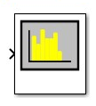
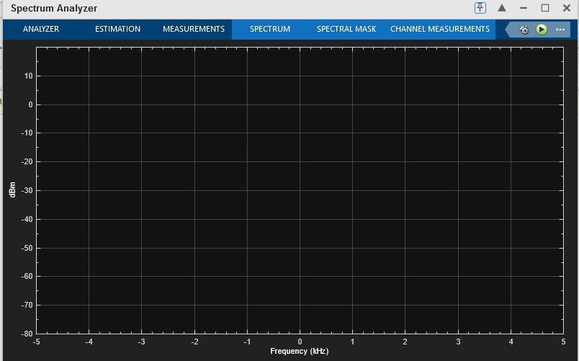
Activity 2 – Method 2 - Spectrum Analyzer

Slide 19
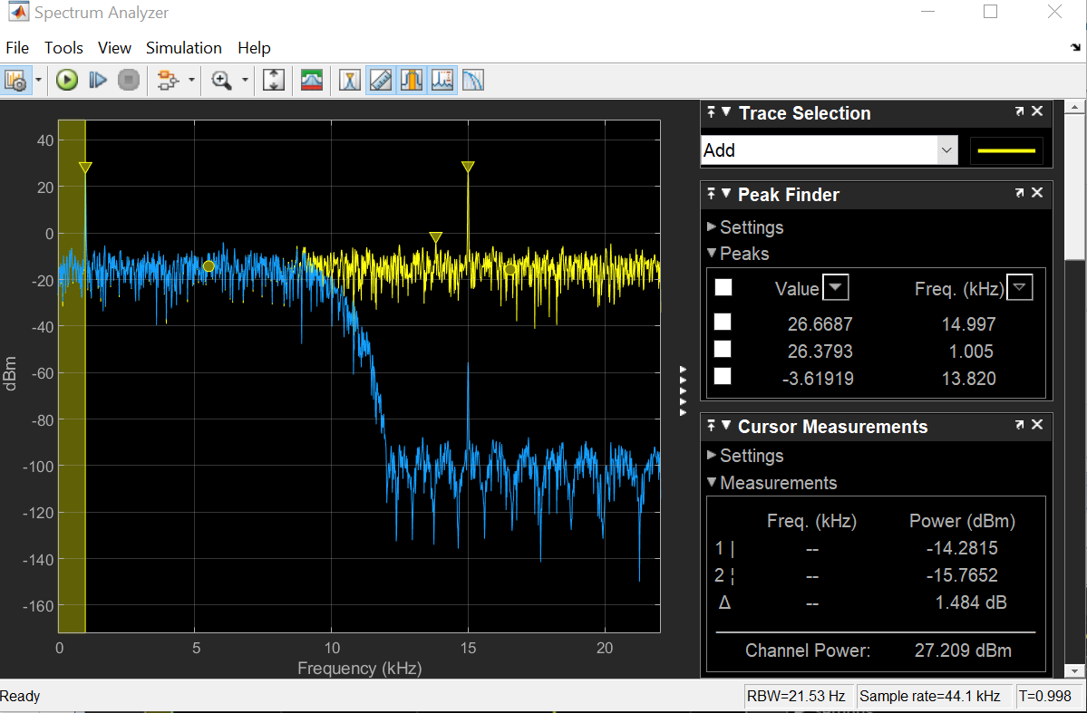
Activity 2 – Method 2 - Spectrum Analyzer
Settings view in the spectrum analyzer

Slide 20
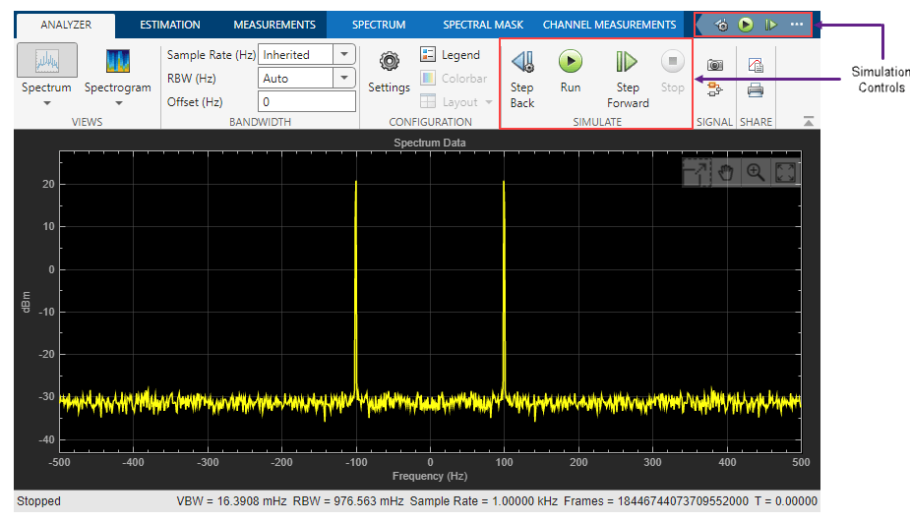
Activity 2 – Method 2 - Spectrum Analyzer

Slide 21
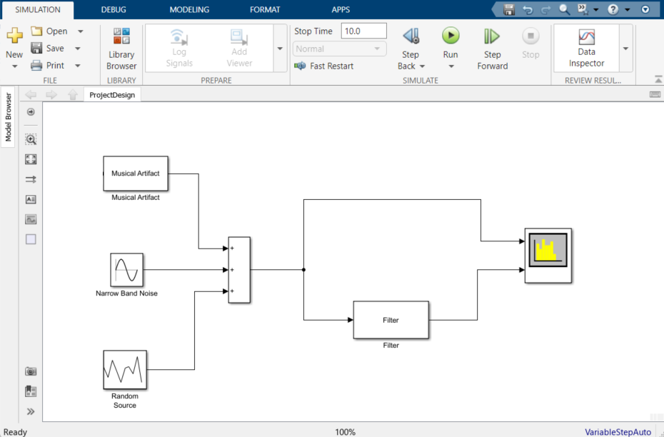
Activity 3 – Filter Application (1/4)
Objective: analyze each filter’s ability (or lack thereof) to protect a primary input signal from a noisy environment. This analysis is conducted within the Simulink environment defined below.
The primary input signal (PIS) is a Simulink compatible audio file (e.g. m4a) selected from a library like https://musical-artifacts.com). The PIS is applied to the Musical Artifact block.
The analysis is conducted in comparing
the frequency spectrum of the PIS without
noise with the filtered spectrum of the PIS
mixed with noise.
The noise shall be one the following signals
A sinewave alone applied to the
Narrow Band Noise (NBN) block
A Gaussian white noise alone applied
to the Random Source block. This signal
is also called Broad Band Noise (BBN)
Both NBN and BBN applied at the same
time.

Slide 22
Activity 3 – Filter Application (2/4)
Operations – Narrow Band Noise Protection Analysis
Process the following steps for each filter.
Step 1: Characterize the PIS spectrum in dB value in identifying its half-power bandwidth [f_{PISmin}, f_{PISmax}]
Project demonstration extra-credit: Play the PIS through the audio system of your laptop
Step 2: Mix the PIS with a Narrowband Noise (NBN) defined as follows:
Signal type: sinewave
Frequency = PIS’ center frequency =(1/2)(f_{PISmin} + f_{PISmax})
RMS amplitude = PIS’ average amplitude over the half-power bandwidth [fmin, fmax]
Step 3: Display the spectrum of the non-filtered compound signal PIS mixed with NBN denoted as PIS&NBN
Characterize the Signal to Noise ratio of PIS&NBN
Project demonstration extra-credit: Play PIS&NBN through the audio system of your laptop
Step 4: Display the spectrum of the filtered PIS&NBN denoted as F_ PIS&NBN
Characterize the Signal to Noise ratio of F_ PIS&NBN
Project demonstration extra-credit: Use the audio system of your laptop to play the following:
PIS alone
PIS&NBN
F_ PIS&NBN
Step 5: Use the Spectrum Analyzer capability or use a subtractor block to compare PIS with PIS&NBN
Step 6: Summarize your findings and conclude as to the efficiency of the filtering. If you have determined that the filter is not efficient, provide an explanation as to why. Which of the 2 assigned is most capable to protect the PIS against a Broad Band noise?

Slide 23
Activity 3 – Filter Application (3/4)
Operations – Broad Band Noise Protection Analysis
Process the following steps for each filter.
Step 1: Characterize the PIS spectrum in dB value in identifying its half-power bandwidth [f_{PISmin}, f_{PISmax}]
Project demonstration extra-credit: Play the PIS through the audio system of your laptop
Step 2: Mix the PIS with a Broad Band Noise (BBN) defined as follows:
Signal type: White Noise Gaussian
Mean amplitude = PIS’ average amplitude over the half-power bandwidth [f_{PISmin}, f_{PISmax}]
Standard deviation = RMS value of the PIS spectrum over its half-power bandwidth [f_{PISmin}, f_{PISmax}]
Step 3: Display the spectrum of the non-filtered compound signal PIS mixed with BBN denoted as PIS&BBN
Characterize the Signal to Noise ratio of PIS&BBN
Project demonstration extra-credit: Play PIS&BBN through the audio system of your laptop
Step 4: Display the spectrum of the filtered PIS&BBN denoted as F_ PIS&BBN
Characterize the Signal to Noise ratio of F_ PIS&BBN
Project demonstration extra-credit: Use the audio system of your laptop to play the following:
PIS alone
PIS&BBN
F_ PIS&BBN
Step 5: Use the Spectrum Analyzer capability or use a subtractor block to compare PIS with PIS&BBN
Step 6: Summarize your findings and conclude as to the efficiency of the filtering. If you have determined that the filter is not efficient, provide an explanation as to why. Which of the 2 assigned is most capable to protect the PIS against a Broad Band noise?

Slide 24
Activity 3 – Filter Application (4/4)
Operations – Comparison of Narrow Band (NB) Broad Band (BB) Noise Filtering
Comparison 1: Which type of noise signal is the easiest to filter?
Comparison 2: What filter is most efficient in protecting against:
NBN?
BBN?
Optimized filter
The filters were designed without any information about the noise characteristics. Now, that the noise characteristics are available, propose a redesign of the filter that will improve the Signal to Noise ratio by at least 6 dB for NBN.
Project demonstration extra-credit: Show an implementation of the optimized filter.

